Slide 2
Driver Annotations in Depth Part II
Donn Terry
Senior SDE
Static Analysis for Drivers
sdvpfdex@microsoft.com

Slide 3
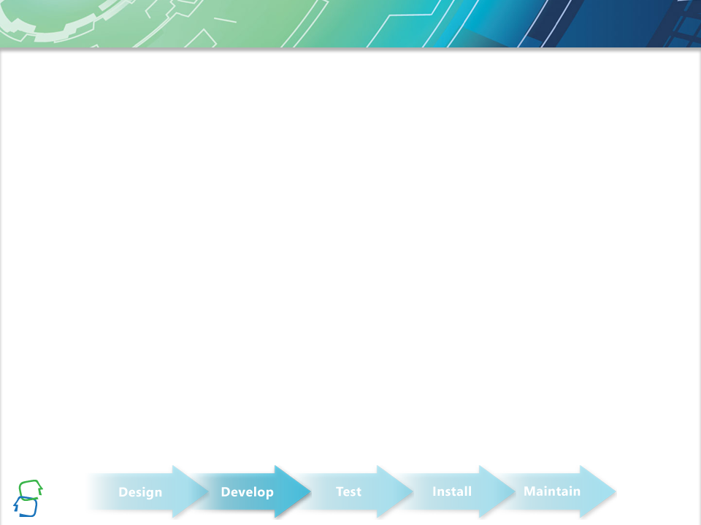
Driver Annotations
The “basic” annotations are a single identifier usually with “in”-ness or “out”-ness as part of the name
Driver annotations are too rich for that to scale
Use __drv_in(<annotation>) (etc.) instead

Slide 4
Problem ‘Kinds’ of Code
Not all driver code is kernel mode
Not all kernel code is driver code
Choose the proper mode of analysis
__kernel_driver; For kernel-mode driver code. This is the default for PREfast for Drivers (PFD).
__kernel_code; For non-driver kernel-mode code
__user_driver; For user-mode driver code
__user_code; For non-driver user-mode code
Place anywhere as a declaration after driverspecs.h (or wdm.h) is included

Slide 5
Problem Typos
PFD can check for many simple but common errors
Passing an incorrect enum value
__drv_strictType, __drv_strictTypeMatch
Passing an incorrect pointer to a PVOID
__drv_isObjectPointer
Constants where variables are needed
Variables where constants are needed
__drv_constant, __drv_nonconstant

Slide 6
Example Enums
NTSTATUS KeWaitForMultipleObjects(
__in ULONG Count,
__in PVOID Object[],
__in
__drv_strictTypeMatch(__drv_typeConst)
WAIT_TYPE WaitType,
__in
__drv_strictTypeMatch(__drv_typeConst)
KWAIT_REASON WaitReason,
__in
__drv_strictType(KPROCESSOR_MODE/enum _MODE,
__drv_typeCond)
KPROCESSOR_MODE WaitMode,
__in BOOLEAN Alertable,
__in_opt PLARGE_INTEGER Timeout,
__in_opt PKWAIT_BLOCK WaitBlockArray);
Never confuse WaitType, WaitReason, and WaitMode again
.

Slide 7
Example Pointers
NTSTATUS
KeWaitForSingleObject(
__in __drv_isObjectPointer PVOID Object,
__in
__drv_strictTypeMatch(__drv_typeConst)
KWAIT_REASON WaitReason,
__in
__drv_strictType(KPROCESSOR_MODE/enum _MODE,
__drv_typeCond)
KPROCESSOR_MODE WaitMode,
__in BOOLEAN Alertable,
__in_opt PLARGE_INTEGER Timeout
);
Never pass &p when you meant p again

Slide 8
Examples Constants
UCHAR
READ_PORT_UCHAR(
__in __drv_nonConstant PUCHAR Port
);
LONG
KeSetEvent(
__in PRKEVENT Event,
__in KPRIORITY Increment,
__in __drv_constant BOOLEAN Wait
);
Avoid unjustified assumptions

Slide 9
Working smarter
PFD can check for known errors
__drv_reportError
Some combination of parameters and state isn’t a good idea.
__drv_preferredFunction
There’s a better way.

Slide 10
Example Checking for errors
__checkReturn
__drv_when((PoolType&0x1f)==2 || (PoolType&0x1f)==6,
__drv_reportError("Must succeed pool allocations are"
"forbidden. Allocation failures cause a system crash"))
PVOID
ExAllocatePoolWithTag(
__in POOL_TYPE PoolType,
__in SIZE_T NumberOfBytes,
__in ULONG Tag
);
Avoid illegal parameters and combinations

Slide 11
Example Preferred Function
DECLSPEC_DEPRECATED_DDK // Use native __int64 math
__drv_preferredFunction("compiler support for 64 bit", "Obsolete")
__inline
LARGE_INTEGER
NTAPI_INLINE
RtlLargeIntegerAdd (
__in LARGE_INTEGER Addend1,
__in LARGE_INTEGER Addend2
);
Encourage good coding practice

Slide 12
Problem Floating point
If your driver uses floating point you must be very careful to protect the hardware.
It’s easy to forget that you used it.
Very hard to find during testing, typically not repeatable, and blue-screen is the usual symptom.
Can span multiple functions
__drv_floatUsed

Slide 13
Example Floating point
long
intSqrt(long i)
{
return (long) sqrt((double)i);
}

Slide 14
Example Floating point
long
intSqrt(long i)
{
return (long) sqrt((double)i);
}
…
if (KeSaveFloatingPointState(b))
{
… intSqrt(…) …
KeRestoreFloatingPointState(b);
}
else // deal with error
…
intSqrt(…) …
…

Slide 15
Example Floating point
__drv_floatUsed
long
intSqrt(long i)
{
return (long) sqrt((double)i);
}
…
if (KeSaveFloatingPointState(b))
{
… intSqrt(…) …
KeRestoreFloatingPointState(b);
}
else // deal with error
…
intSqrt(…) …
…

Slide 16
Tip Transitivity
Check both sides of contract.
__drv_floatUsed relies on it to work.
Used for utility functions with side effects.
PFD’s single function scope seems a problem.
But PFD checks both sides of the contract.
Correctly stated contracts solve the problem.
Use on wrapper functions.

Slide 17
Problem Memory leaks
PFD has always checked, but sometimes was noisy
Checks for using freed memory as well

Slide 18
Memory Leaks Acquire/Release
__drv_allocatesMem(): the function (optionally via out parameter) allocates memory
__drv_freesMem(): the memory is freed (and is no longer accessible)
__drv_aliasesMem: the memory won’t leak and remains accessible

Slide 19
Memory Leaks Requirements
Allocated memory must be:
Freed (reach a __drv_freesMem)
Aliased by exiting the function (via global, out parameter, or function result).
Aliased by reaching __drv_aliasesMem.
Complex data structures.
PFD keeps a “contained by” relationship
If allocated memory has not been freed at the end of the function, PFD follows the “contained by” links until it finds a container that exits the function via a global or function result. (Up to 5 levels, which is a lot statically.)
If it fails, it’s reported as a leak.

Slide 20
Memory Leaks “Possibly Leaking” messages
The “Possibly Leaking” messages indicate that the value reached a call that if annotated with __drv_aliasesMem would not have reported a warning.
Does the called function really “keep” the value?
Yes: fix with annotation (likely will fix a lot).
No: you’ve found a leak.

Slide 21
Example Memory allocation
NTKERNELAPI
NTSTATUS
IoCreateDevice(
__in PDRIVER_OBJECT DriverObject,
__in ULONG DeviceExtensionSize,
__in_opt PUNICODE_STRING DeviceName,
__in DEVICE_TYPE DeviceType,
__in ULONG DeviceCharacteristics,
__in BOOLEAN Exclusive,
__out
__drv_out(__allocatesMem(Memory)) // see the book (deref implied)
PDEVICE_OBJECT *DeviceObject
);
Detect many leaks

Slide 22
Example Aliasing memory
PDEVICE_OBJECT
__checkReturn
IoAttachDeviceToDeviceStack(
__in PDEVICE_OBJECT SourceDevice,
__in
__drv_in(__drv_mustHold(Memory)
__drv_when(return!=0, __drv_aliasesMem))
PDEVICE_OBJECT TargetDevice
);
Reduce false positives

Slide 23
Example Freeing memory
NTKERNELAPI
VOID
IoDeleteDevice(
__in __drv_freesMem(Memory)
PDEVICE_OBJECT DeviceObject
);
Don’t access freed memory

Slide 24
Problem Leaked locks (or other resources)
“Things” you acquire and release are resources.
They can “leak” like memory, but the memory annotations don’t quite work for Lock type objects (I tried).
Resources are also “richer”:
Must or never hold. (And no double take/free.)
Can be put into/taken out of other objects.
Some can be “named”.

Slide 25
Resources Acquire/Release
__drv_acquiresResource(kind)
__drv_releasesResource(kind)
__drv_acquiresResourceGlobal(kind,param)
__drv_releasesResourceGlobal(kind,param)
‘kind’ is just a name (an arbitrary string)
‘param’ is “named by” (when there are many)

Slide 26
Resources Holding
__drv_mustHold(kind)
__drv_neverHold(kind)
__drv_mustHoldGlobal(kind,param)
__drv_neverHoldGlobal(kind,param)
Implements:
Exclusivity/Non-recursion
Unsafe situations (e.g. IoCompleteRequest)

Slide 27
Resources Specializations
Exclusive (shorthand)
__drv_acquiresExclusiveResource(kind)
__drv_releasesExclusiveResource(kind)
__drv_acquiresExclusiveResourceGlobal(kind, param)
__drv_releasesExclusiveResourceGlobal(kind, param)
The cancel spin lock
__drv_acquiresCancelSpinLock
__drv_releasesCancelSpinLock
__drv_mustHoldCancelSpinLock
__drv_neverHoldCancelSpinLock
The critical region
__drv_acquiresCriticalRegion
__drv_releasesCriticalRegion
__drv_mustHoldCriticalRegion
__drv_neverHoldCriticalRegion

Slide 28
Example Acquire/Release
__drv_maxIRQL(DISPATCH_LEVEL)
__drv_savesIRQL
__drv_setsIRQL(DISPATCH_LEVEL)
_DECL_HAL_KE_IMPORT
KIRQL
FASTCALL
KfAcquireSpinLock (
__inout __deref __drv_acquiresExclusiveResource(SpinLock)
PKSPIN_LOCK SpinLock);
__drv_maxIRQL(DISPATCH_LEVEL)
__drv_minIRQL(DISPATCH_LEVEL)
_DECL_HAL_KE_IMPORT
VOID
FASTCALL
KfReleaseSpinLock (
__inout __deref __drv_releasesExclusiveResource(SpinLock)
PKSPIN_LOCK SpinLock,
__in __drv_restoresIRQL KIRQL NewIrql
);

Slide 29
Example Must/Never Hold
__drv_maxIRQL(APC_LEVEL)
__drv_mustHoldCriticalRegion
__drv_valueIs(==1)
__drv_when(Wait==0, __drv_valueIs(==0;==1) __checkReturn)
NTKERNELAPI
BOOLEAN
ExAcquireResourceSharedLite (
__inout __deref __drv_neverHold(ResourceLite)
__deref __drv_when(return!=0, __drv_acquiresResource(ResourceLite))
PERESOURCE Resource,
__in BOOLEAN Wait);

Slide 30
Example Spin lock wrapper
VOID
GetMySpinLock(
__inout
__drv_deref(__drv_acquiresResource(SpinLock))
PKSPIN_LOCK SpinLock
)
{
(void)KeAcquireSpinLock(SpinLock);
}
(Ignoring old IRQL value for clarity.)
Transitive annotations empower checks

Slide 31
Problem Wrong IRQL
Some functions can only be called at raised IRQL. Some must never be.
Some functions can change the IRQL. Some can never do so.
Some functions can temporarily change the IRQL, some shouldn’t.
How high is safe?
Tracking the combinations can be hard.

Slide 32
IRQLs
Many things can be done wrong.
Some are simply losing track of the context.
Some are due to incomplete analysis in code changes.
Some are not understanding what IRQLs do.
Static analysis can find many of these, and the better the annotation, the more it can find.

Slide 33
Function changes the IRQL
__drv_sameIRQL: modifies the IRQL but promises to put it back where it was.
__drv_raisesIRQL: raises it.
__drv_setsIRQL: changes it (use rarely).
__drv_restoresIRQL, __drv_restoresIRQLGlobal: undoes a raise/set.

Slide 34
Required IRQLs
__drv_maxIRQL: maximum you can call it at.
__drv_minIRQL: minimum you can call it at.
__drv_requiresIRQL: just exactly one.
__drv_functionMaxIRQL: function never exceeds.
__drv_functionMinIRQL: function never goes below.

Slide 35
Saving
__drv_savesIRQL, __drv_savesIRQLGlobal
The “Global” annotations save/restore from a PFD-created location invisible to the program, matching the semantics of some functions.

Slide 36
Example
__drv_maxIRQL(DISPATCH_LEVEL)
__drv_minIRQL(APC_LEVEL)
F13();
__drv_requiresIRQL(PASSIVE_LEVEL)
F0();
void F()
{
…
F13();
F0();
…
}
PFD will report an error at the call to F0, although it could be the F13 call that’s wrong.
If the call to F13 is successful, then the call to F0 can’t be.
If the call to F0 is required, then F13 must be protected (or not used).
Usually F13 and F0 are far apart. PFD tries to find the “other one”.

Slide 37
Example
__drv_raisesIRQL(APC_LEVEL)
__drv_savesIRQL
int raise();
void lower (__drv_restoresIRQL int i);
__drv_sameIRQL
void F()
{
…
old = raise();
F13();
lower(old)
F0();
…
}
No error reported here: this is safe.

Slide 38
Example
__drv_raisesIRQL(APC_LEVEL)
__drv_savesIRQL
int raise();
void lower (__drv_restoresIRQL int i);
__drv_functionMaxIRQL(PASSIVE_LEVEL)
__drv_sameIRQL
void F()
{
…
old = raise();
F13();
lower(old)
F0();
…
}
Error reported: raise() raises to APC_LEVEL, but this function says that’s not OK.

Slide 39
Example
__drv_raisesIRQL(APC_LEVEL)
__drv_savesIRQL
int raise();
void lower (__drv_restoresIRQL int i);
__drv_minIRQL(DISPATCH_LEVEL)
__drv_sameIRQL
void F()
{
…
old = raise();
F13();
lower(old)
…
}
Error reported: we know we’re at DISPATCH (or higher). We can’t raise to a lower level.

Slide 40
Example
__drv_functionMaxIRQL(APC_LEVEL)
__drv_sameIRQL
void F()
{
…
old = raise();
F13();
lower(old)
F0();
…
}
__drv_functionMaxIRQL(PASSIVE_LEVEL)
void G()
{
F();
}
Error reported in G(): G() should never raise above passive level.

Slide 41
Example Callbacks
typedef
__drv_sameIRQL
__drv_clearDoInit(yes)
__drv_functionClass(DRIVER_ADD_DEVICE)
NTSTATUS
DRIVER_ADD_DEVICE (
__in struct _DRIVER_OBJECT *DriverObject,
__in struct _DEVICE_OBJECT *PhysicalDeviceObject
);
typedef DRIVER_ADD_DEVICE *PDRIVER_ADD_DEVICE;
Check for correct implementation

Slide 42
__drv_inTry Required Exception Handler
__drv_inTry
Code must be inside the body of a structured exception handler (SEH): try/except, try/finally.
__drv_notInTry
Code cannot be inside a SEH body.
Transitive just like __drv_floatUsed
__drv_inTry
__drv_maxIRQL(APC_LEVEL)
NTKERNELAPI
VOID
NTAPI
ProbeForRead (
...
__drv_inTry
void ProbeDWORD(void *p)
{
ProbeForRead(p, 4, 4);
}

Slide 43
Problem Paged functions
PAGED_CODE must be used with #pragma alloc_text
Frequently one or the other is missed
Not quite an annotation, but a lot like one
Predates PFD
Sets __drv_maxFunctionIRQL
PAGED_CODE_LOCKED needed in some special cases
Works with (dynamic) Driver Verifier

Slide 44
Tip Things to remember
There’s more:
Read the documents
Read the documentation on warning messages as you get them.
Always use the macros – that’s what will be supported
Stick to the predefined macros
Annotate for the success case
Annotate to the design, not the implementation
Look at issues by line number, not warning number.
Start early

Slide 45
Running PFD
Preferred: Microsoft Automated Code Review (OACR)
Runs automatically in the background
If needed: stand-alone PREfast command
Works from many environments besides the normal build environment.
Identical versions, but OACR has a richer filter capability, so some warnings may differ.

Slide 46
OACR Customization
Add/modify %INIT%\oacruser.ini (pick one or make your own)
[defaults]
;All PFD rules
ErrorNumbers=<level0>;<level1>;<level2>;<level3_PFD_samples>;<level_4_PFD>
[defaults]
;All rules
ErrorNumbers=<all>
[defaults]
;Specific ones
ErrorNumbers=<level0>;<level1>;<level2>;281xx;281yy;…
Don’t Forget:
oacr set all
OACR chalk talk later.

Slide 47
On Correctness
Annotations help with assuring correctness.
In a recent IEEE Computer article, the writer asserts that for “critical” code, the code should be “obviously correct”.
Modulo Hoare Expression proofs or equivalent.
Windows is critical for business infrastructure.

Slide 48
On Correctness
Code which is not obviously correct…
--- is obviously not correct.

Slide 49
Additional Resources
Web resources
WHDC Web site
PREfast step-by-step http://www.microsoft.com/whdc/DevTools/tools/PREfast_steps.mspx
PREfast annotations http://www.microsoft.com/whdc/DevTools/tools/annotations.mspx
How to Use Function typedefs in C++ Driver Code to Improve PREƒast Results http://go.microsoft.com/fwlink/?LinkId=87238
Blog: http://blogs.msdn.com/staticdrivertools/default.aspx
WDK documentation on MSDN
PREfast for Drivers http://msdn.microsoft.com/en-us/library/aa468782.aspx
Chapter 23 in Developing Drivers with the Windows Driver Foundation
http://www.microsoft.com/MSPress/books/10512.aspx
E-mail sdvpfdex @ microsoft.com

Slide 50
Related Sessions
Session | Day / Time
Using Static Analysis Tools When Developing Drivers | Mon. 8:30-9:30
Driver Annotations in Depth: Part 1 | Mon. 1:30-2:30
Lab: PREfast for Drivers | Mon. 11-12 and Wed. 8:30-9:30
Lab: Static Driver Verifier for WDM, KMDF, and NDIS | Mon. 5:15-6:15 and Wed. 11-12
Integrating PREfast into Your Build by Using Microsoft Auto Code Review | Tues. 4-5
Using Static Driver Verifier to Analyze KMDF Drivers | Mon. 4-5
Using Static Driver Verifier to Analyze NDIS Drivers | Tues. 9:45-10:45
Using Static Driver Verifier to Analyze Windows Driver Model Drivers | Wed. 9:45-10:45

Slide 51
Questions?

